Slide 1
Міністерство освіти і науки України Державний вищий навчальний заклад «Запорізький Національний Університет» Економіко-правничий коледж Виконав студент групи К34-14 1-го курсу Чубовський Владислав

Slide 2
Valentine's Day in Ukraine

Slide 3
Valentine’s Day is celebrated in many countries worldwide, including in Ukraine, on February 14. It is viewed as a romantic day and a time when people show feelings of love, affection, and appreciation to their loved ones.
http://yandex.ua/images/search?text=valentine%27s%20day&stype=image&lr=141&noreask=1&source=wiz&uinfo=sw-1280-sh-800-ww-1255-wh-652-pd-1-wp-16x10_1280x800

Slide 4
Valentine’s Day is a time when people show feelings of love, affection and friendship. It is celebrated in many ways worldwide and falls on February 14 each year.

Slide 5
What do people do?
Many people around the world celebrate Valentine’s Day by showing appreciation for the people they love or adore. Some people take their loved ones for a romantic dinner at a restaurant while others may choose this day to propose or get married. Many people give greeting cards, chocolates, jewelry or flowers, particularly roses, to their partners or admirers on Valentine’s Day.
http://en.academic.ru/dic.nsf/enwiki/122370

Slide 6
Valentine’s Day is not a public holiday in many countries, including Australia, Canada, the United Kingdom and the United States. However, restaurants, hotels and shopping centers may be busy around this time of the year.
Public life

Slide 7
Symbols
Hearts, the colors red and pink, roses symbolize the feeling of romance and love on Valentine’s Day. The day focuses on love, romance, appreciation and friendship.
http://en.academic.ru/dic.nsf/enwiki/122370

Slide 8
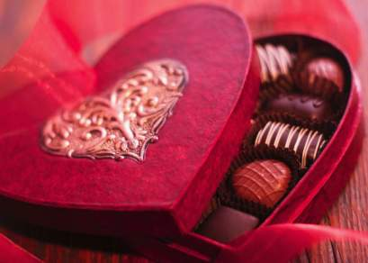
Lovers send love notes, Valentine's cards, chocolates, flowers and gifts.

Slide 9
Background
There are a number of Saints called Valentine who are honored on February 14. The day became associated with romantic love in the Middle Ages in England. Traditionally, lovers exchanged hand written notes. Commercial cards became available in the mid nineteenth century.

Slide 10
Tradition of Valentine's Cards
Over the centuries, the holiday evolved, and by the 18th century, gift-giving and exchanging hand-made cards on Valentine's Day had become common in England. Hand-made valentine cards made of lace, ribbons, and featuring cupids and hearts eventually spread to the American colonies.

Slide 11
Modern times
In 1797, a British publisher issued The Young Man's Valentine Writer, which contained scores of suggested sentimental verses for the young lover unable to compose his own.
Paper Valentines became so popular in England in the early 19th century. Fancy Valentines were made with real lace and ribbons, in the mid-19th century.
http://www.dinternal.com.ua/country-study/saint-valentines-day/

Slide 12
A classic emblem of Valentine's Day
A classic emblem of Valentine's Day is red roses and "Valentines card", this emblem appeared in 15 century. This invention belongs to Charles Duke of Orleans, who, struggling with boredom in prison, wrote love letters to his wife. By 16th century "valentines card" had become very popular. Nowadays, "valentines card" can be easily sent by e-mail.
http://www.dinternal.com.ua/country-study/saint-valentines-day/

Slide 13
Traditional concerts, beauty contests are held on Saint Valentine's Day in Ukraine. Much attention is paid to promotion of a healthy lifestyle.

Slide 14
You've given me a reason For smiling once again, You've filled my life with peaceful dreams and you've become my closest friend. You've shared your heartfelt secrets And your trust you've given me, You showed me how to feel again To laugh, and love, and see. If life should end tomorrow And from this world I should part, I shall be forever young For you have touched my heart http://www.poemsource.com/valentine-poems.html
If you want to declare your love the romantic way, here is a poem:

Slide 15
Thank you

