Slide 1
Д’ячкова Дарія к 14-14
МІНІСТЕРСТВО ОСВІТИ І НАУКИ УКРАЇНИ ДЕРЖАВНИЙ ВИЩИЙ НАВЧАЛЬНИЙ ЗАКЛАД
«ЗАПОРІЗЬКИЙ НАЦІОНАЛЬНИЙ УНІВЕРСИТЕТ» ЕКОНОМІКО-ПРАВНИЧИЙ КОЛЕДЖ
СВЯТО
ІВАНА КУПАЛА

Slide 2
Daria Dyachkova
KUPALA
K 14-14

Slide 3
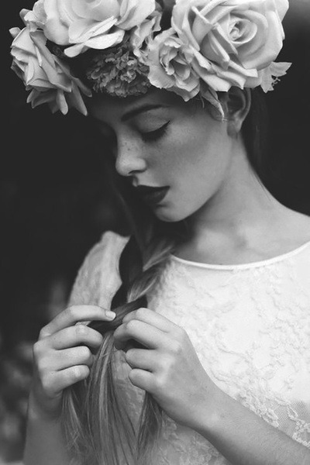
The holiday of the summer sun - Kupala.

Slide 4
It is devoted to the summer solstice and the continuing of life. It is celebrated 0n 7th July.

Slide 5
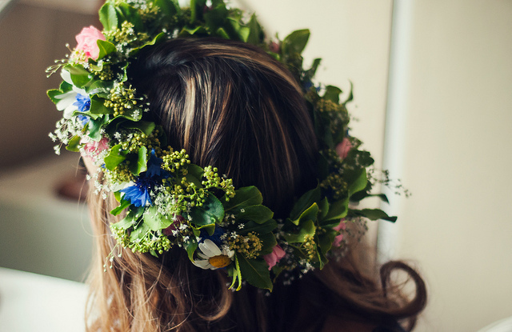
Each girl makes garlands of flowers – for herself and her beloved.

Slide 6
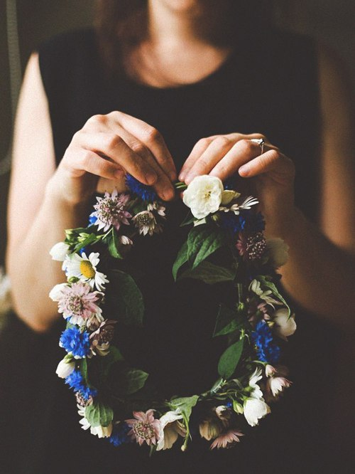
Then she puts them on the water while singing Kupala songs and thinking of her future destiny.

Slide 7
Another symbol of the festival is Marena. This is a life-sized doll which looks like a scarecrow.

Slide 8
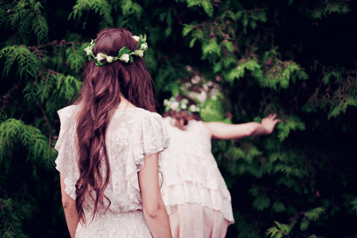
Girls secretly make it out of straw on the Kupala eve and place it in the sand to dance around.

Slide 9
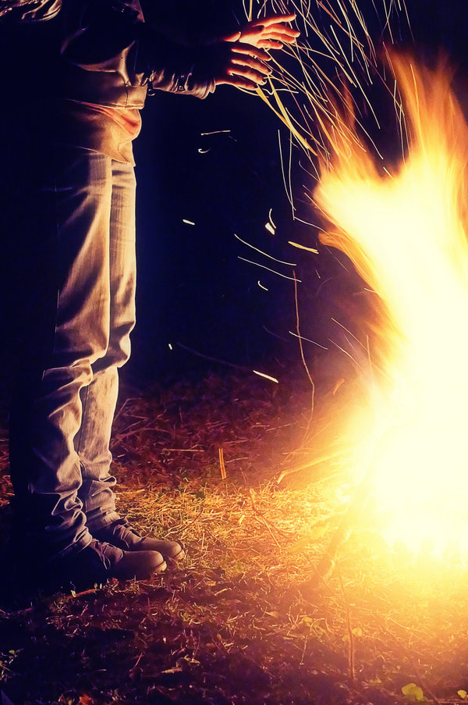
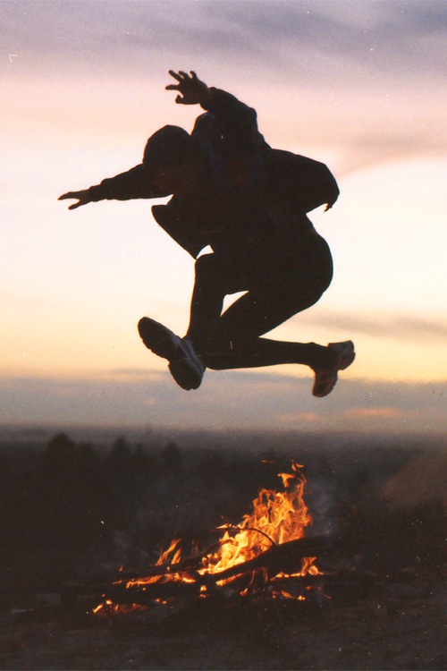
At night young people make bonfires and jump over them three times.

Slide 10
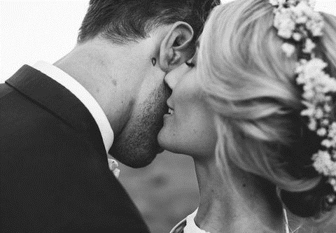
It is believed that you’ll be successful if you do it safely.

Slide 11
In St.John’s Night searched fern flower which was to bring the finder happiness and wisdom.

Slide 12
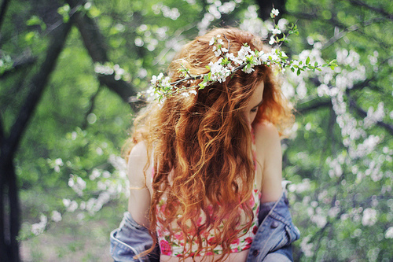
Unusual fern flower blooms once a year – just in Midsummer Night.

Slide 13
It is believed that those who take part in the celebration of Ivan Kupala Day, will find happiness and love.

Slide 14
sources of information:
Solutions Intermediate Student’s Book
Solutions Intermediate workbook
tumblr.com
http://www.slideshare.net/sobiana/night-of-kupala-4567535

Slide 15
The end!
Thank you for watching !

