Slide 1
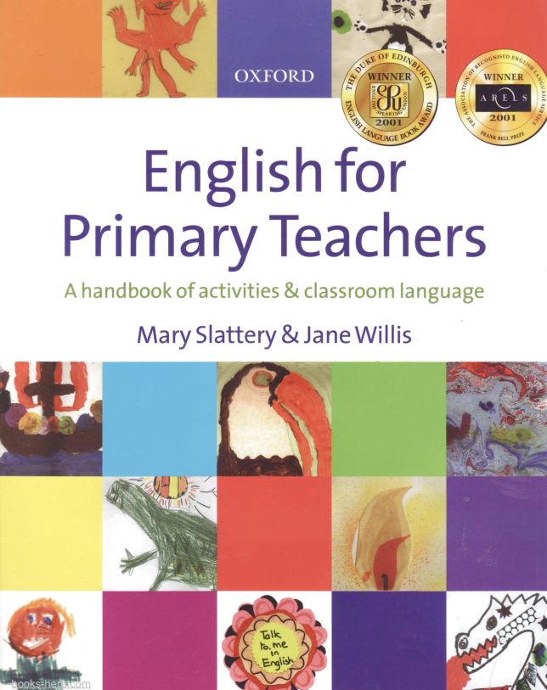
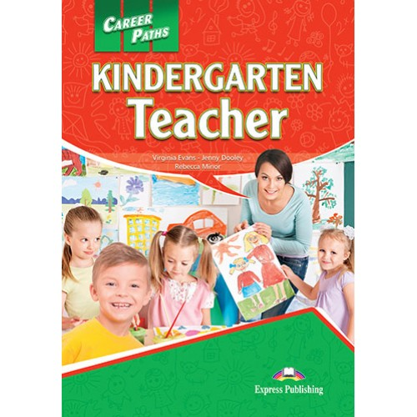
Оцінювання та програма курсу
(телеграм група)

Slide 2

Hello everyone! Let`s meet! (group in telegram)
What`s your name?
What`s your surname?
How old are you?
Where are you from?
What nationality are you?
Where do you live?
Where do you study? Where are you going to study?
What is your future job? Why do you choose it?
Do you work? If yes, where?
What do you like doing in your free time?

Slide 3
Dreaming of Teaching? Here’s How to Begin Your Journey as a Primary School Educator
A career in education can be deeply rewarding and fulfilling, offering the opportunity to make a lasting impact on young learners. As a primary school teacher, you can help shape children’s minds during some of their most formative years, nurturing their academic and social development. This might be an ideal career path if you enjoy working with young children and have strong patience, communication, and leadership skills. In this article, we’ll explore the role of a primary school teacher and steps to help you start your journey in this profession.
What is a Primary School Teacher?
A primary school teacher is an educator specialising in teaching children in early education, typically ranging from ages 4 to 11. Primary teachers often work in various settings, including private and public primary schools and some early childhood education centres. Primary school education generally covers foundational subjects and essential skills, setting up students for secondary schooling. The demand for qualified primary school teachers remains high, creating a wide range of career opportunities in this field.

Slide 4
What Does a Primary School Teacher Do?
Primary school teachers play a vital role in guiding young students through foundational subjects like math, reading, science, and social studies. They often create structured lesson plans and organise activities that keep students engaged and make learning enjoyable. Teachers also play a critical role in assessing students’ progress, communicating with parents, and collaborating with other educators to support each child’s development. To teach effectively, primary teachers may use various creative tools, such as music, storytelling, and hands-on activities that resonate with young learners and help them grasp new concepts.
Essential Skills for a Primary School Teacher
Primary school teachers need a range of skills to be successful in their roles:
Patience: Working with young children requires a high degree of patience to handle diverse behaviours and learning paces.
Leadership: Teachers act as role models, guiding students through academics, social interactions, and classroom routines.
Creativity: The ability to design engaging lessons and adapt them to different learning styles is crucial.
Communication: Strong communication skills help teachers explain concepts clearly and work effectively with students, parents, and colleagues.
Organisation: Teachers must often plan their day meticulously, from lessons to extracurricular activities, ensuring every minute counts.
Problem-solving: Addressing individual learning needs and adapting to unforeseen classroom dynamics require a flexible and solution-oriented approach.

Slide 5
Topic:
Classroom objects
Aims: to find out the classroom staff and discuss its usage and benefits

Slide 6
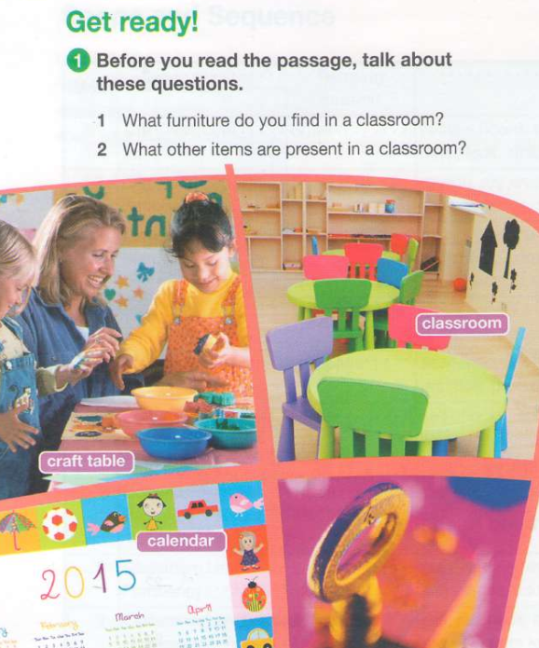

Slide 7
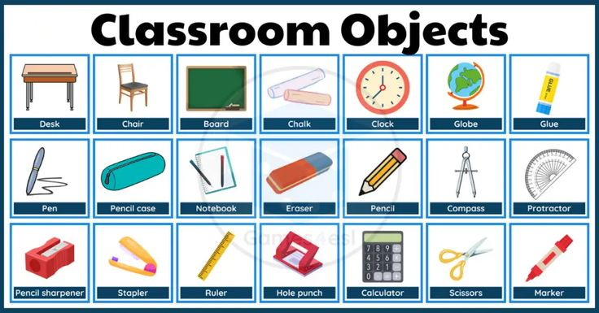
A typical classroom includes desks, chairs, white boards or greenboards for writing on and usually a computer stand as well. The teacher's table with chair is also present in addition to cupboard space that can be used by teachers when they need additional storage room next to their desk area.

Slide 8
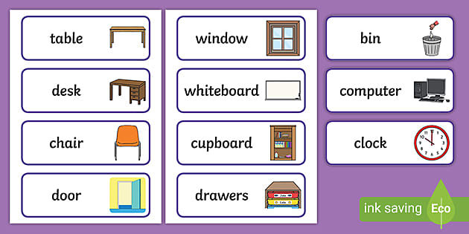

Slide 9
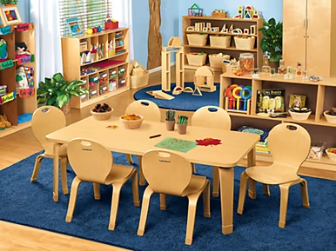
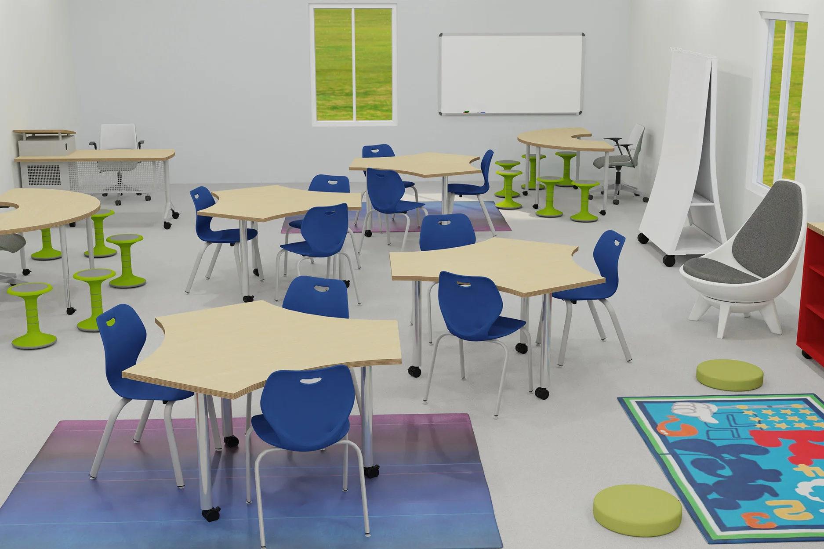
Classroom furniture includes student desks and chairs, teacher desks, whiteboards or pinboards, and various storage solutions like bookshelves, cupboards, and lockers. The type of furniture is chosen based on the age of the students, the learning activities (individual work, group collaboration, or whole-class instruction), and the need to create a comfortable, organized, and engaging environment that supports learning and concentration.

Slide 10
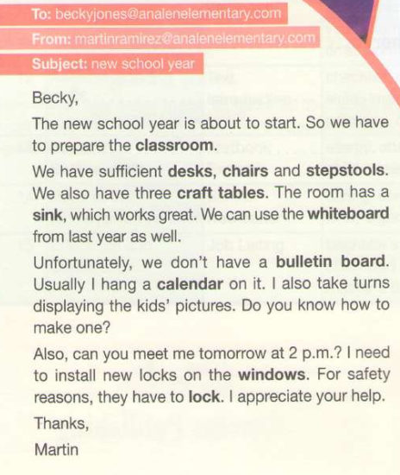
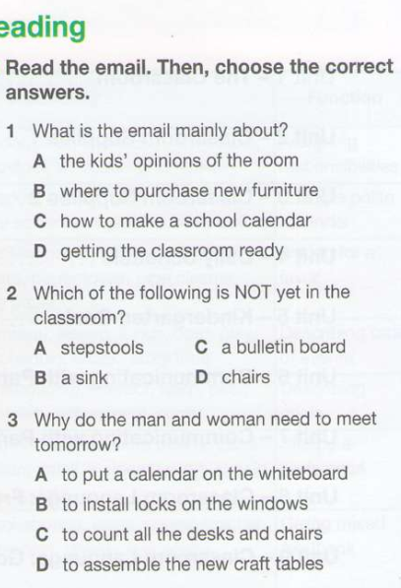

Slide 11
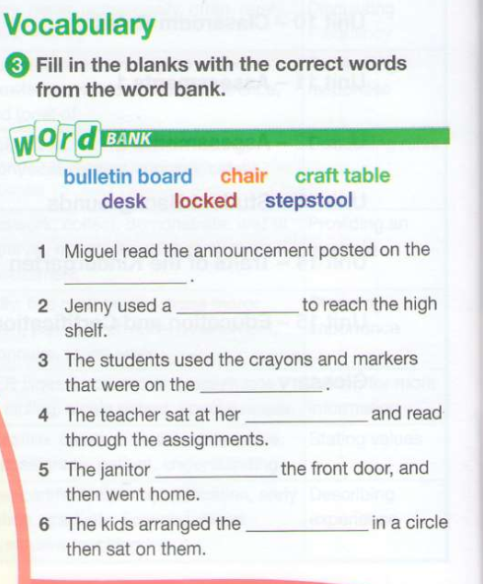
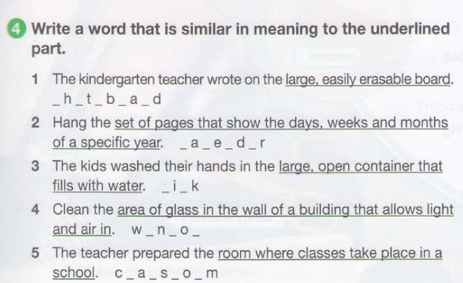

Slide 12
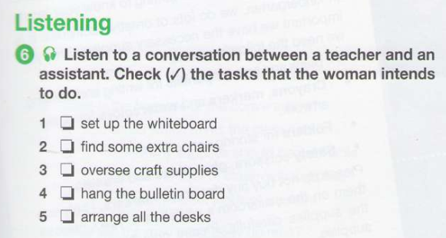
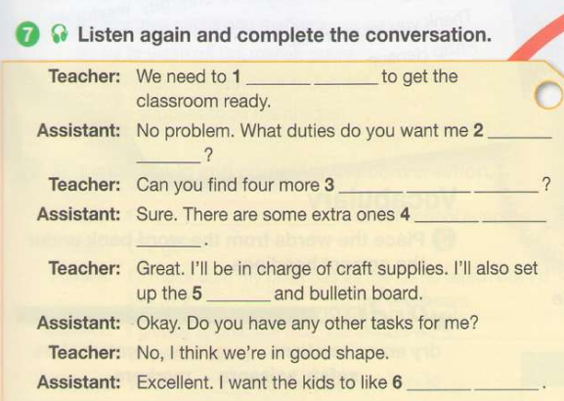


Slide 13
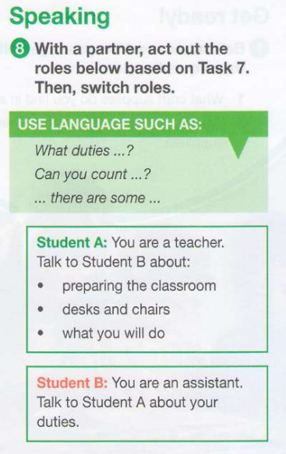


Slide 14
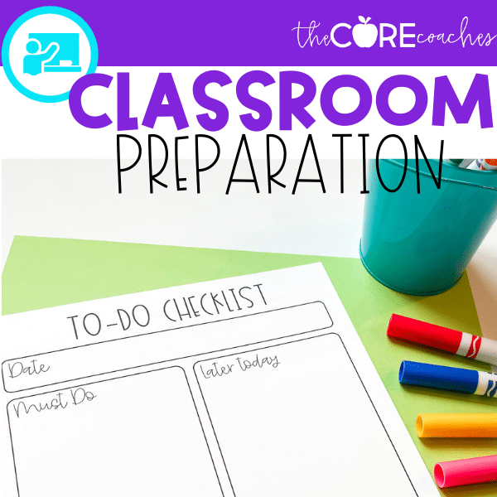
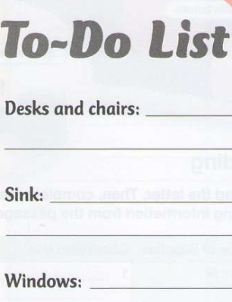
Home work: Ex 9 p 5 напишіть, що необхідно підготувати перед початком нового навчального року використовуючи бесіду вчителя та асистента.

