Slide 1
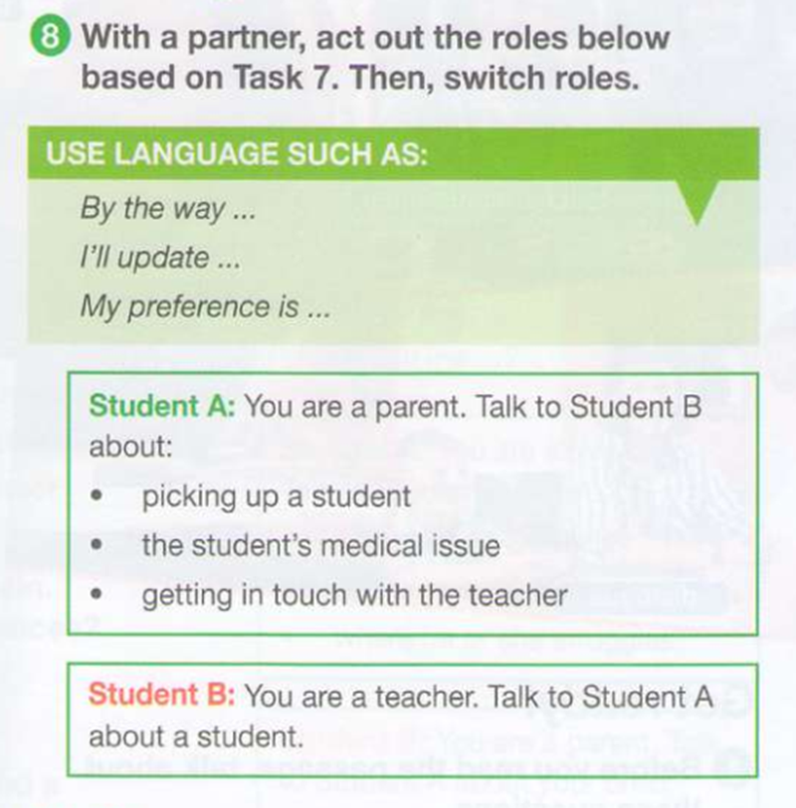
Checking home work

Slide 2

Topic of the lesson
Communication with parents
Key points:
-Parent-teacher conference
-Dialogue
-Concerning

Slide 3
Topic`s vocabulary
Praising
Praise
to express admiration or approval of the achievements or characteristics of a person or thing
collaborate
Review
concerns
to work with someone else for a special purpose
to describe the most important facts in a piece of academic research (= detailed study of a subject) that you have read, and give your opinion of the research
a worried or nervous feeling about something, or something that makes you feel worried

Slide 4
Crucial issues!!!
What are parent-teacher conferences?
Why are they useful?

Slide 5
A parent-teacher conference (PTC) is a short meeting between you and your child's teacher to talk about your child's academic performance and experience at school. These meetings help you understand what your child is learning at school, their academic and social-emotional progress, and what you can do to support them.
A parent-teacher conference is a great opportunity to: share academic progress and growth based on classroom observations, testing data, assessments, portfolios, and assignments. learn from parents or guardians so you can be better informed about students' strengths, needs, behaviors, and learning styles.

Slide 6

https://www.youtube.com/watch?v=7--8asB4J8w https://www.youtube.com/watch?v=BEQxLHsFUOs
Successful teacher-parent conference

Slide 7
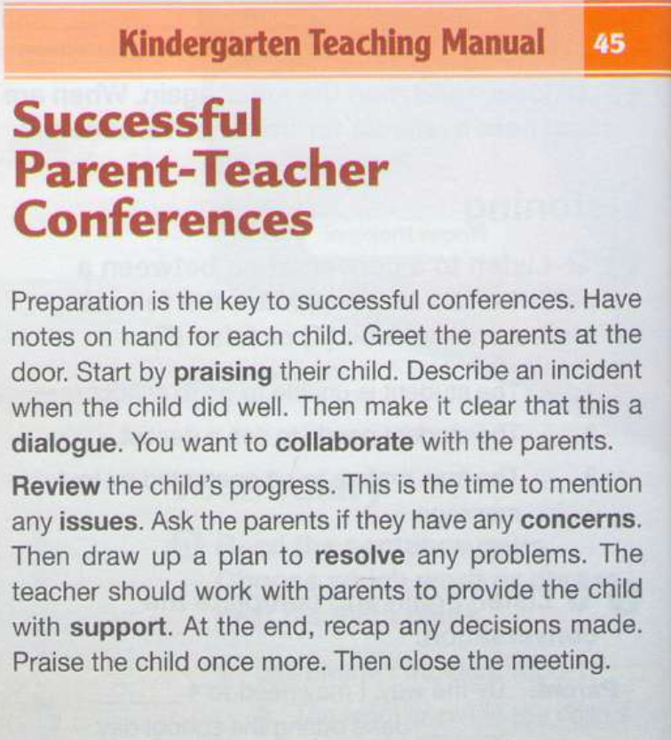
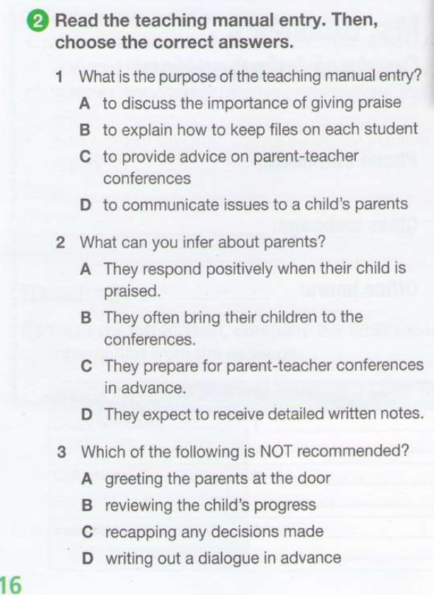

Slide 8
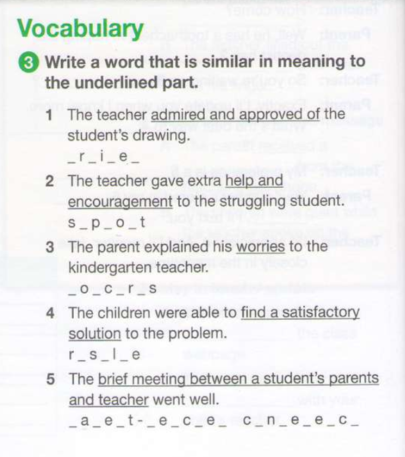
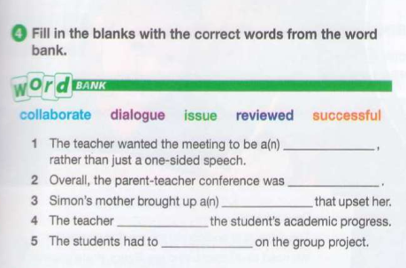

Slide 9
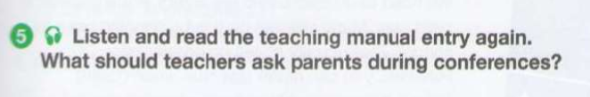


Slide 10
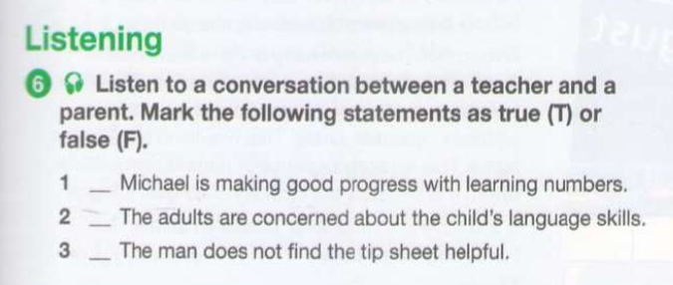
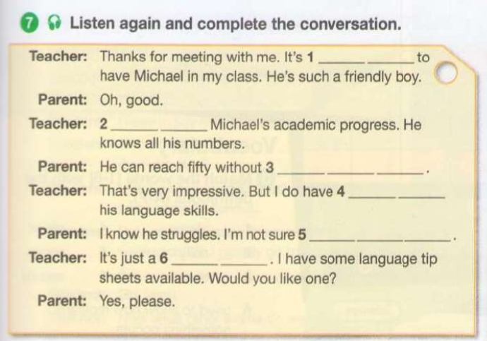

Slide 11
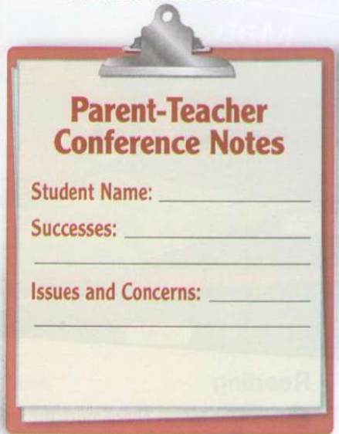
Home work

